Slide 1








Understanding Recommender Systems
An overview of recommender systems, their types, and applications.

Slide 2




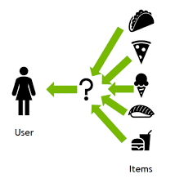


What is a Recommender System?
A recommender system predicts user preferences for items, enhancing user experience through personalized suggestions.
These systems are crucial in various industries, including e-commerce and entertainment, driving engagement and improving customer satisfaction.

Slide 3



Types of Recommender Systems
1
Hybrid Approaches
2
Content-Based Filtering
3
Collaborative Filtering

Slide 4



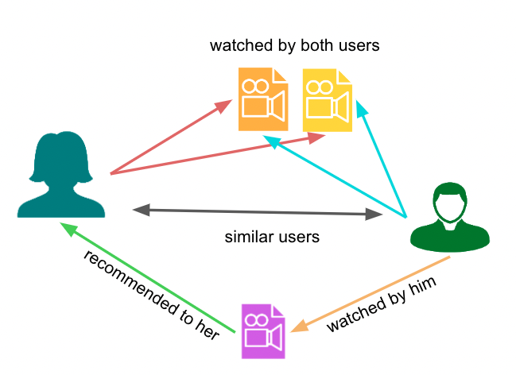
Collaborative Filtering
This method recommends items based on the preferences of similar users.
It includes user-based and item-based filtering, allowing for personalized recommendations without needing item metadata.

Slide 5
Advantages of Collaborative Filtering
1
Can discover new user preferences.
2
No need for item metadata.

Slide 6
Challenges of Collaborative Filtering
1
Scalability issues with large datasets.
2
Cold start problem for new users/items.

Slide 7

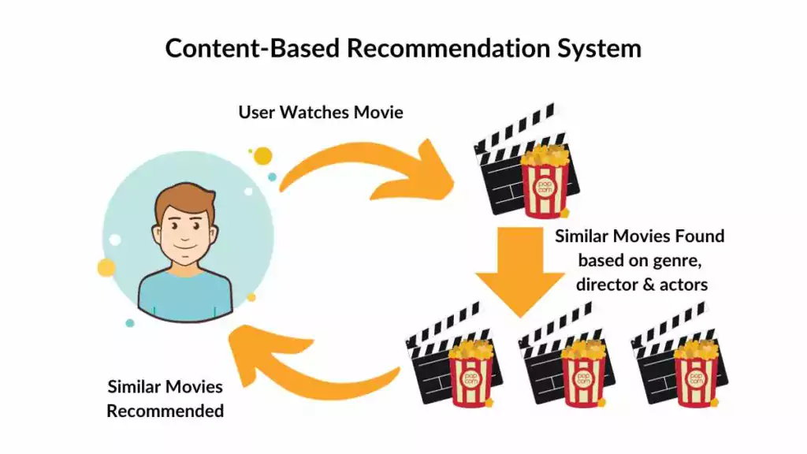


Content-Based Filtering
This method recommends items based on their attributes and the user's past interactions.
It uses item features to suggest similar items, ensuring relevance to user preferences.

Slide 8
Advantages of Content-Based Filtering
1
Transparent recommendations based on identifiable features.
2
Handles cold start for new items.

Slide 9
Challenges of Content-Based Filtering
1
Risk of over-specialization in recommendations.
2
Limited by known item features.

Slide 10
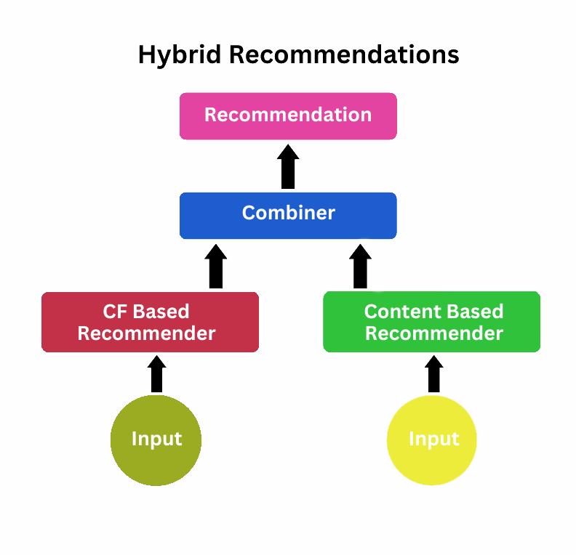
Hybrid Approaches
Hybrid recommender systems combine collaborative and content-based filtering to enhance recommendation quality.
They address the limitations of both methods, providing a more diverse range of suggestions.

Slide 11
Advantages of Hybrid Approaches
1
Increased diversity in suggestions.
2
Mitigates cold start issues.
3
Improved accuracy in recommendations.

Slide 12
Challenges of Hybrid Approaches
1
Higher computational resource requirements.
2
Complex implementation and maintenance.

Slide 13
Case Study – Mint's Use of Recommender Systems
An in-depth analysis of how Mint utilizes recommender systems to enhance user experience and financial management.

Slide 14
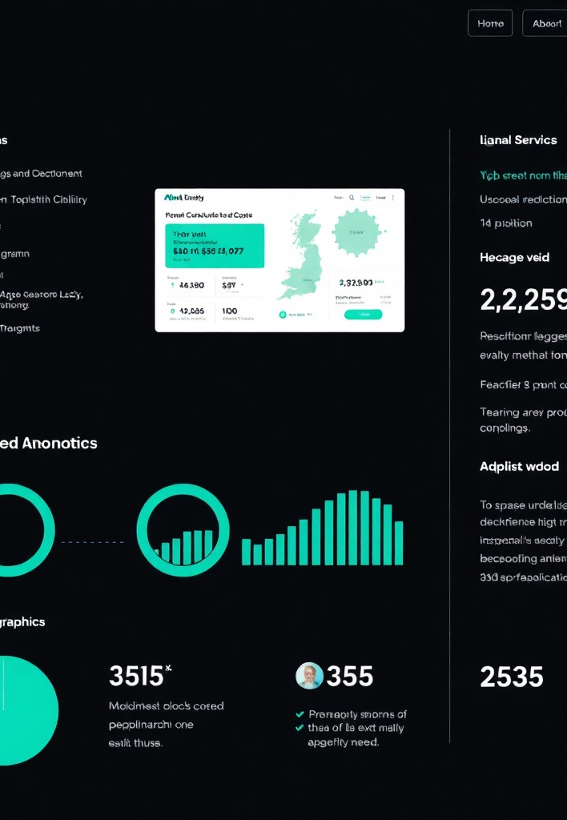
Introduction to Mint
Mint is a personal finance management platform founded in 2006 and acquired by Intuit in 2009.
It offers services like budgeting, expense tracking, investment monitoring, and credit score monitoring.
With millions of users from diverse demographics, Mint aims to help users achieve effective financial management.

Slide 15

Mint's Objective with Recommender Systems
Mint aims to provide personalized financial planning advice tailored to individual situations.
The system enhances user engagement and decision-making, empowering users to make informed financial choices.
Additionally, it helps maintain a competitive edge in the FinTech space.

Slide 16

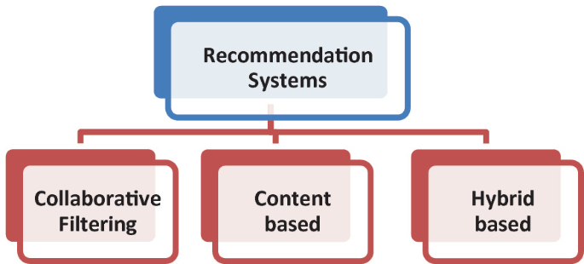
Type of Recommender System Used by Mint
Mint primarily uses User-Based Collaborative Filtering, analyzing behaviors of users with similar financial patterns.
This method effectively identifies user patterns and provides personalized insights without needing extensive item metadata.

Slide 17
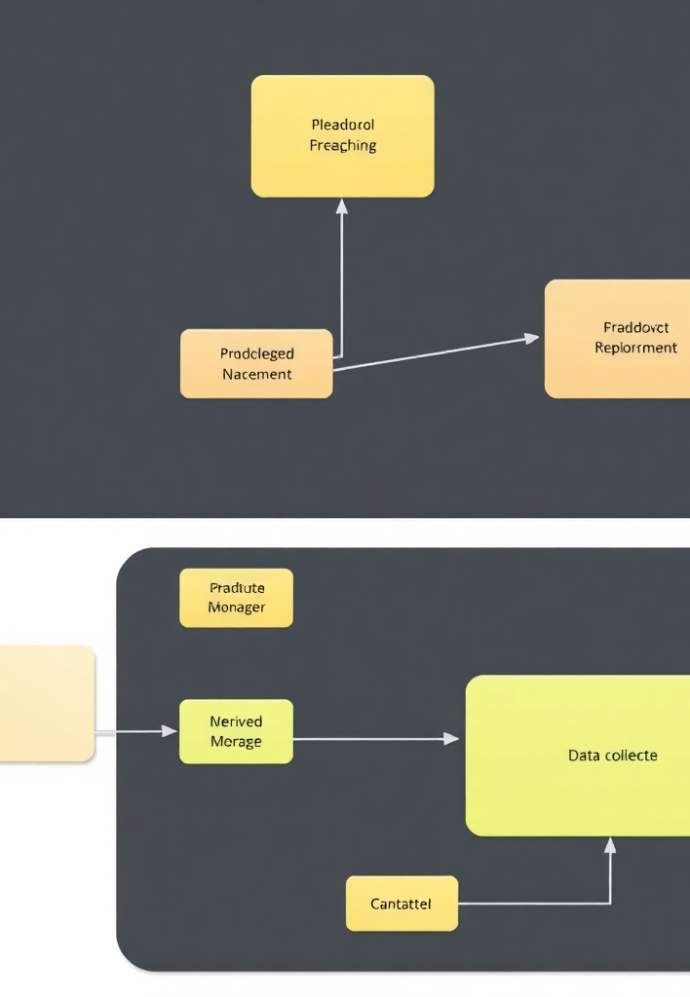
Data Collection and Processing in Mint
Mint acquires user data through account linking and transaction history.
Data cleaning and normalization ensure accuracy, while real-time processing allows dynamic updates to recommendations, providing immediate feedback to users.

Slide 18
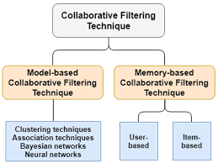
Collaborative Filtering Techniques in Mint
Mint employs algorithms like Euclidean Distance and Cosine Similarity to measure user similarity.
K-Means Clustering groups users with similar behaviors, facilitating targeted recommendations based on peer financial behaviors.

Slide 19

Machine Learning and AI Integration
Mint integrates advanced machine learning algorithms for data analysis, including Random Forests and Neural Networks.
AI-driven insights help predict future user needs and detect anomalies, enhancing user engagement with adaptable recommendations.

Slide 20

User Profiling and Personalization Strategies
Mint continuously updates dynamic user profiles based on interactions, including various financial metrics.
Personalization strategies involve goal setting, tracking, and customized notifications, leading to highly personalized financial recommendations.

Slide 21
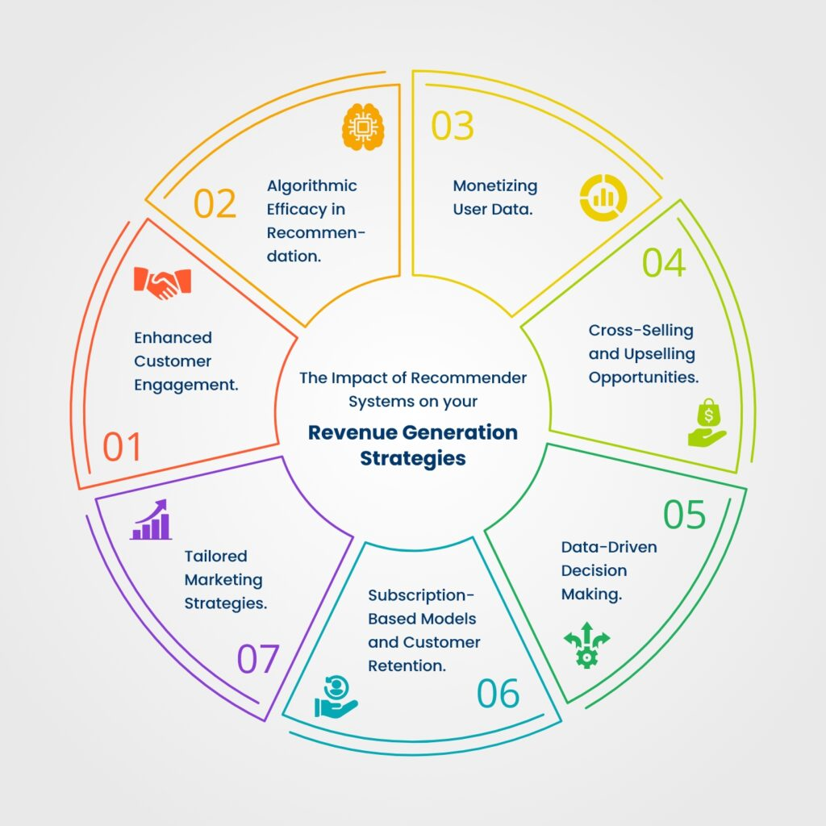
Impact on Users
Mint enhances financial awareness by providing a holistic view of financial status and insightful analytics.
Users benefit from improved budgeting, goal achievement, and increased app usage due to personalized content.

Slide 22

Benefits of Personalization in Financial Planning
Personalization improves decision-making and customer satisfaction while leading to better financial outcomes.
However, it also raises data privacy concerns and potential algorithm bias, highlighting the complexity of implementation.

Slide 23

Challenges Faced by Mint and Solutions
Mint faces challenges like data privacy, accuracy, and algorithm bias.
Solutions include robust encryption, machine learning enhancements, and regular monitoring of algorithms to ensure fairness and accuracy.

Slide 24

Evaluation and Results
Mint's effectiveness metrics show increased budget adherence and user savings.
User satisfaction surveys reveal high scores, with success stories highlighting significant financial improvements for users, contributing to Mint's competitive advantage.

Slide 25

Thanks!

